Slide 1
데이터 분석 기초!
-데이터 파악하기, 다루기 쉽게 수정하기

Slide 2
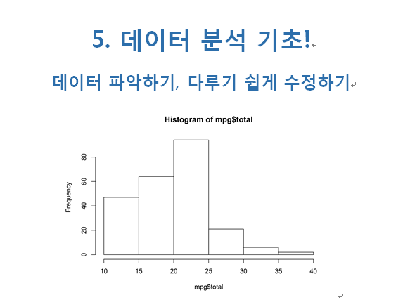

Slide 3
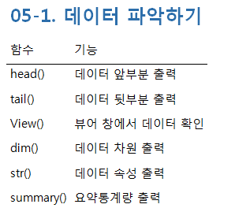
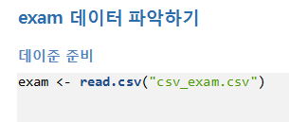

Slide 4
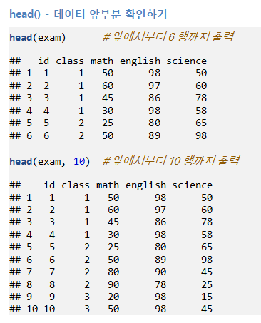

Slide 5
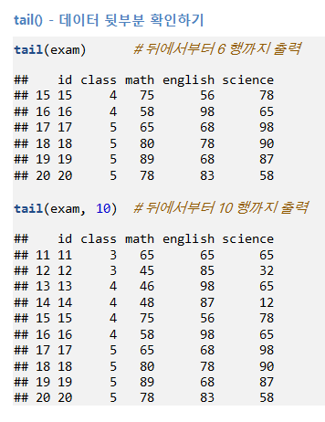

Slide 6
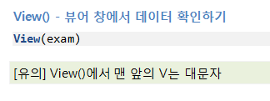
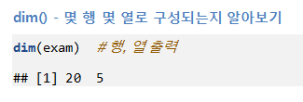
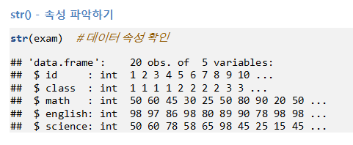

Slide 7
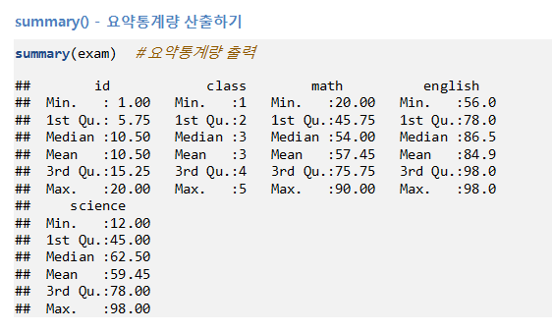

Slide 8
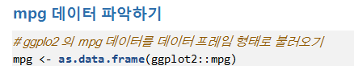
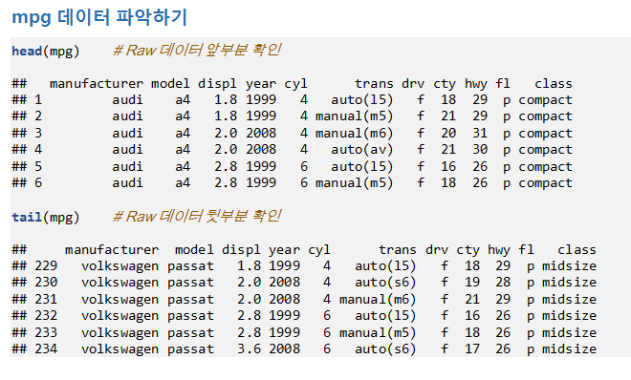

Slide 9
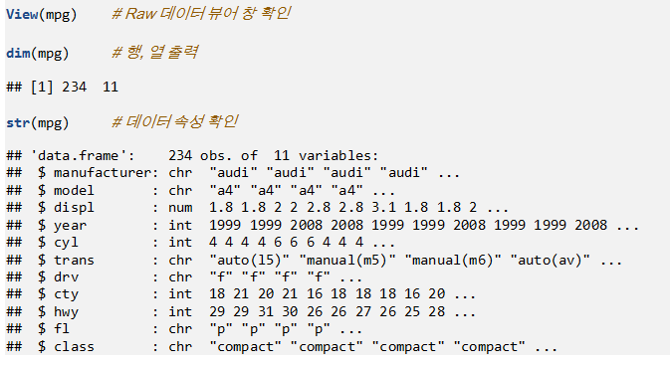

Slide 10
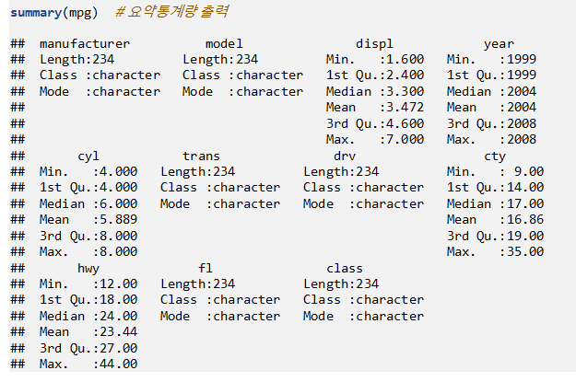

Slide 11
exam<-read.csv("csv_exam.csv")
exam
head(exam)
head(exam,10)
tail(exam)
tail(exam,10)
View(exam)
dim(exam)
str(exam)
summary(exam)
install.packages("ggplot2")
mpg<-as.data.frame(ggplot2::mpg)
head(mpg)
tail(mpg)
View(mpg)
dim(mpg)
str(mpg)
summary(mpg)

Slide 12
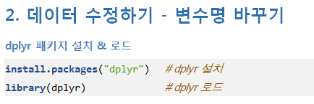
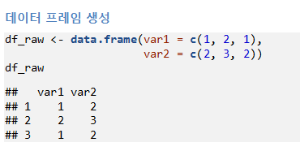
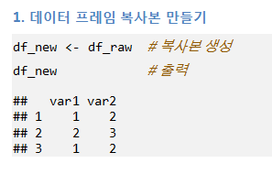

Slide 13
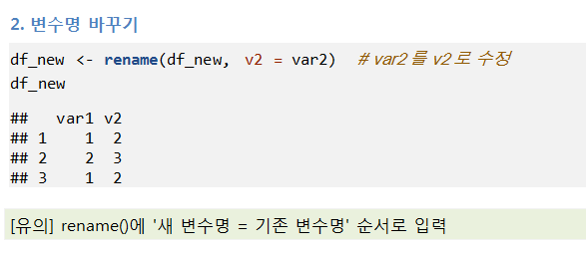
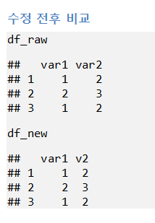

Slide 14
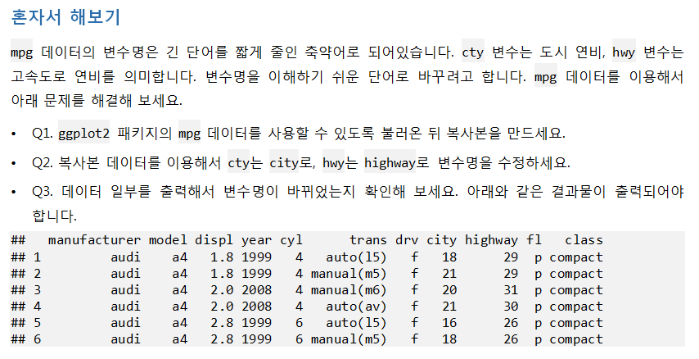

Slide 15
필요한 library:
Ggplot2,dplyr
mpg<-as.data.frame(ggplot2::mpg)
mpg
df_new<-mpg
df_new
df_new<-rename(df_new,city=cty)
df_new<-rename(df_new,highway=hwy)
df_new

Slide 16
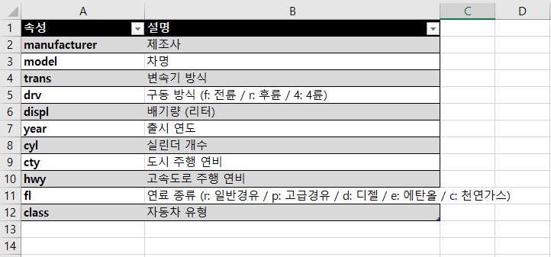
mpg data

Slide 17
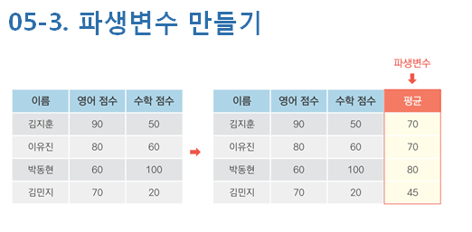
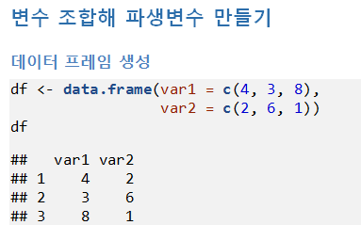

Slide 18
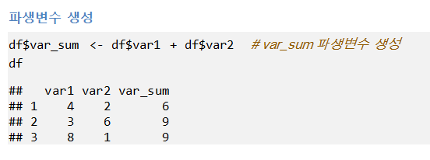
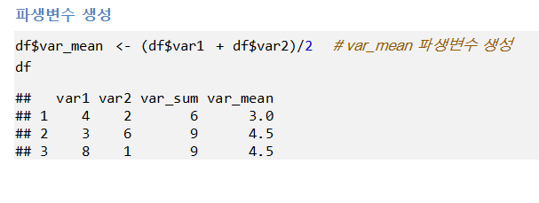

Slide 19
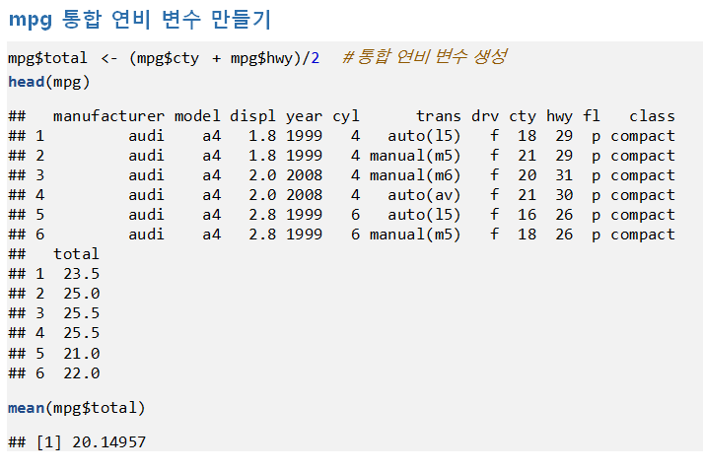

Slide 20
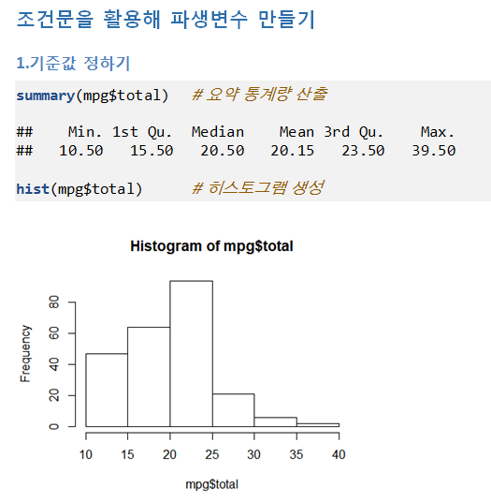

Slide 21
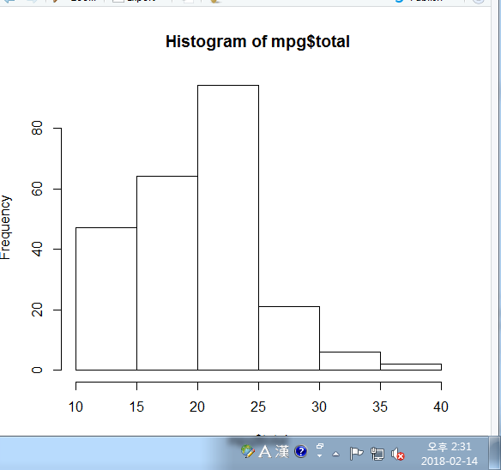
df<-data.frame(var1=c(4,3,8),var2=c(2,6,1))
df
df$var_sum<-df$var1+df$var2
df
df$var_mean<-(df$var1+df$var2)/2
df
mpg$total<-(mpg$cty+mpg$hwy)/2
head(mpg)
mean(mpg$total)
summary(mpg$total)
hist(mpg$total)

Slide 22
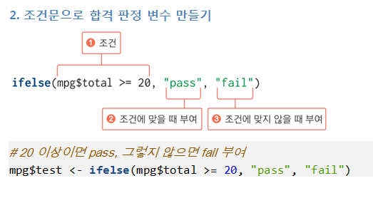

Slide 23
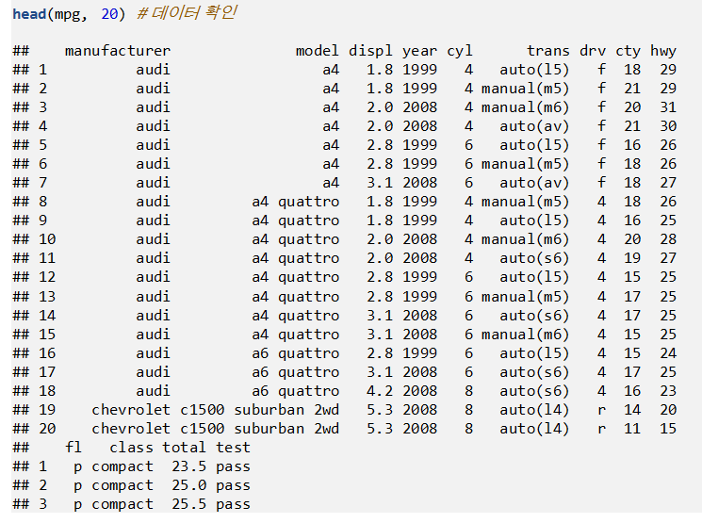

Slide 24
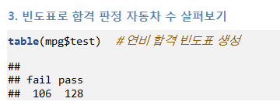
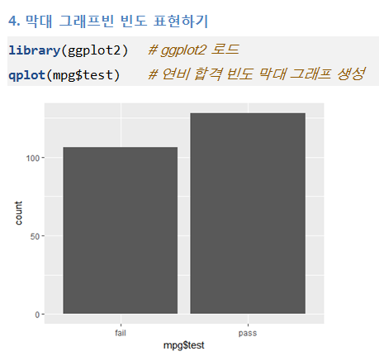

Slide 25
ifelse(mpg$total>=20,"pass","fail")
mpg$test<-ifelse(mpg$total>=20,"pass","fail")
head(mpg,20)
table(mpg$test)
qplot(mpg$test)

Slide 26
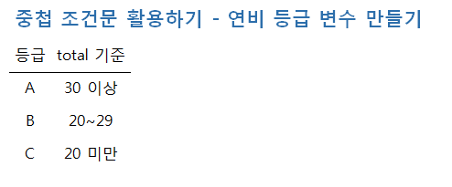

Slide 27
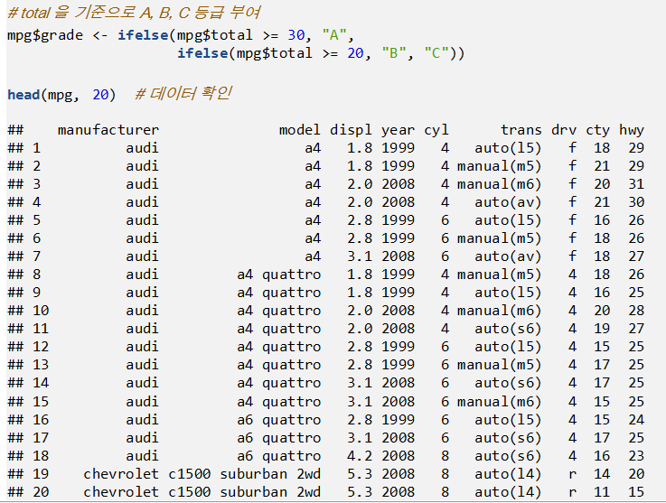

Slide 28
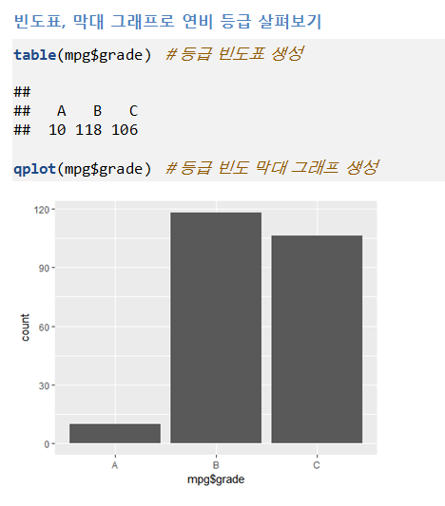

Slide 29
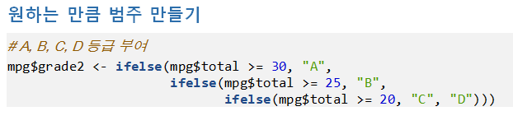

Slide 30
p121
mpg$grade2<-ifelse(mpg$total>=30,"A",
ifelse(mpg$total>=25,"B",
ifelse(mpg$total>=20,"C","D")))
head(mpg,20)
table(mpg$grade2)

Slide 31
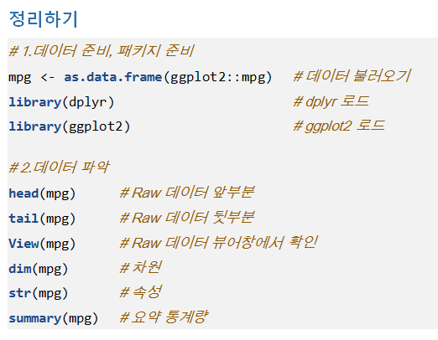

Slide 32
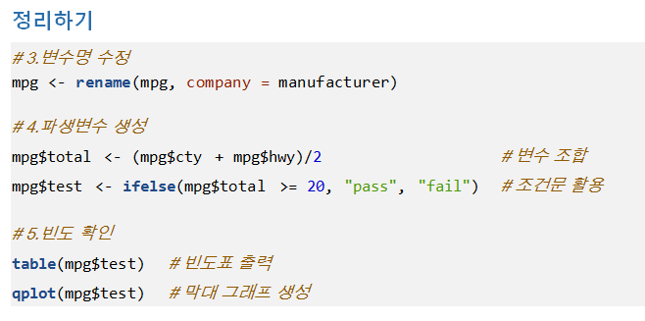

Slide 33
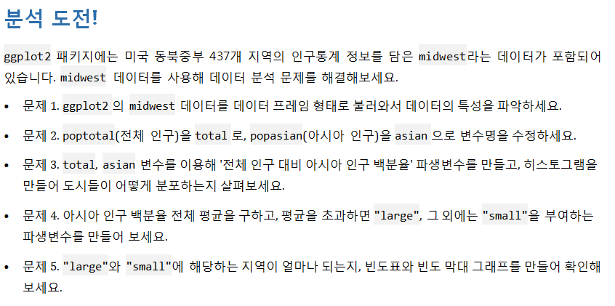

Slide 34
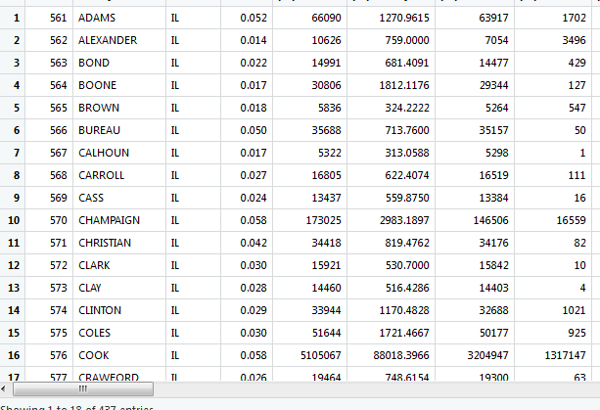
midwest<-as.data.frame(ggplot2::midwest)
head(midwest)
tail(midwest)
View(midwest)
dim(midwest)
str(midwest)

